Slide 1
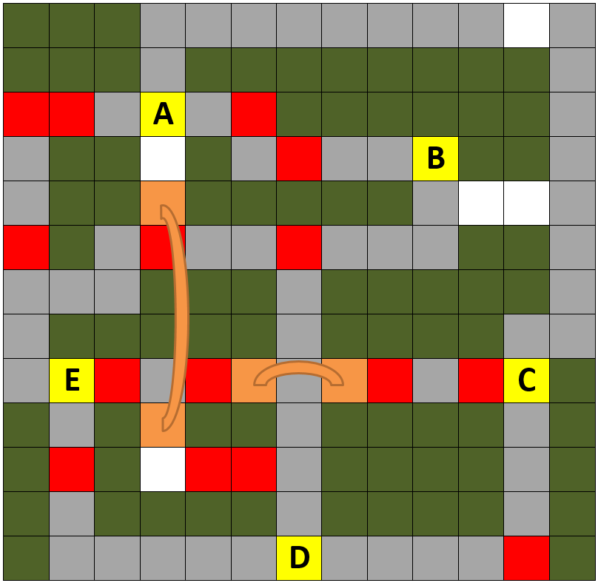

Simple Algorithms to Teach the Ideas Behind Coding

Slide 2
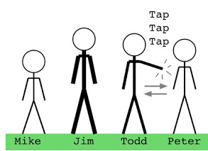
Provide a set of informative and engaging activities to the students
Sorting with Algorithms
Efficient Pathing

Slide 3
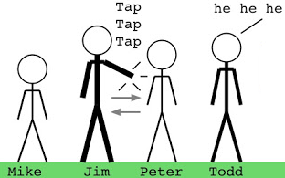
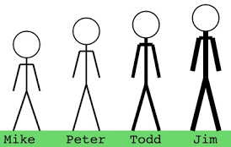
We will have students sort themselves by height
Students will be instructed to line up and sort themselves by height, only switching with those next to them. They will have completed the classic “bubble sort” algorithm. What better algorithms are there?

Slide 4
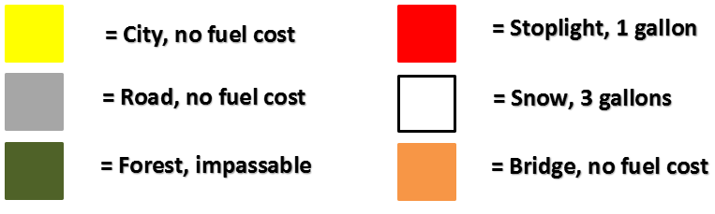
Have students find efficient paths through different terrain types
A key indicates the cost of traversing each type of terrain
Students are given a grid with various terrain

Slide 5
Simple Algorithms to Teach the Ideas Behind Coding
Students will be instructed to line up and sort themselves by height, only switching with those next to them.
Find the most efficient path.

